Slide 1
D-311 Unit 3: Radios

Slide 2
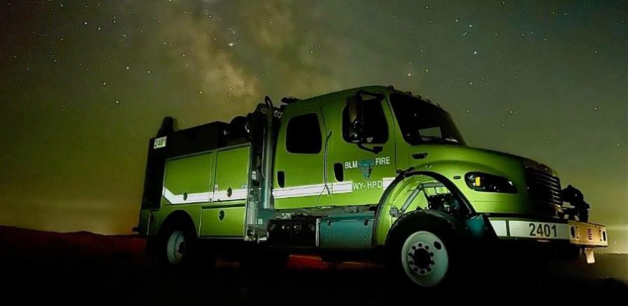
Objectives
Students will be able to :
List three steps of clear and concise radio communications.
List five standard radio traffic priorities.
Identify frequency types and radio systems.
Describe five methods of frequency management.
List and describe three types of frequencies used for aircraft.

Slide 3
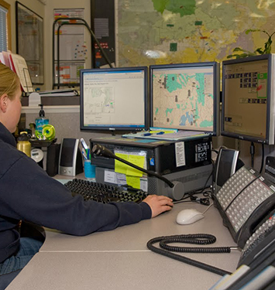
Radio Communication
Purpose of communicating:
To convey important information
Examples:
Life threatening, injury, major accidents
Flight following
New & ongoing incidents
Firefighter and public safety are always the first priority.

Slide 4
Radio Communication
Clear and Concise Radio Communication and Documentation
Organize thoughts and actions to minimize airtime.
  Meaningful information
  Minimize radio traffic
Plan and organize messages.
  Preplanning every message allows you to pre-read longer announcements, such as weather

Slide 5
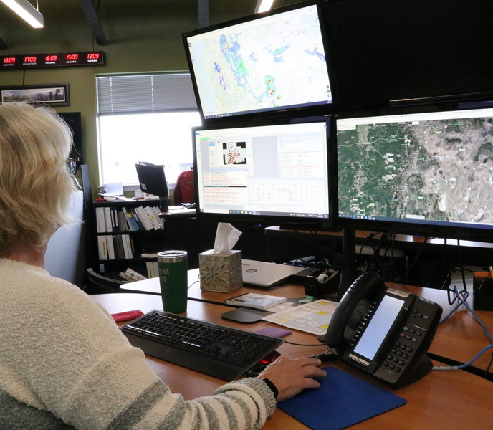
Radio Communication
Clear and Concise Radio Communication and Documentation
The dispatcher sets the tone of radio traffic
  Positive and professional manner
  Gain composure before talking

Slide 6
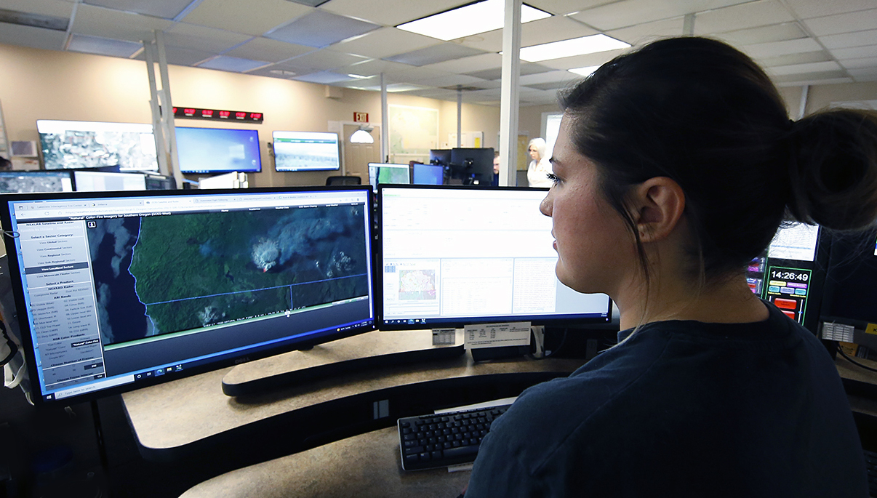
Radio Communication
Clear and Concise Radio Communication and Documentation
Radio Techniques
  Keying the microphone
  Wait up to three seconds before transmitting
  Ensure volume is set to a reasonable level be able to hear incoming traffic
  Situational awareness of the microphone (no hot mics)

Slide 7
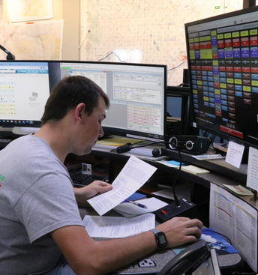
Radio Communication
Clear and Concise Radio Communication and Documentation
Radio Transmissions
  Understand information being passed and transmissions
  Establish positive contacts
  Clear channels when needed
  Be prepared for emergency traffic

Slide 8
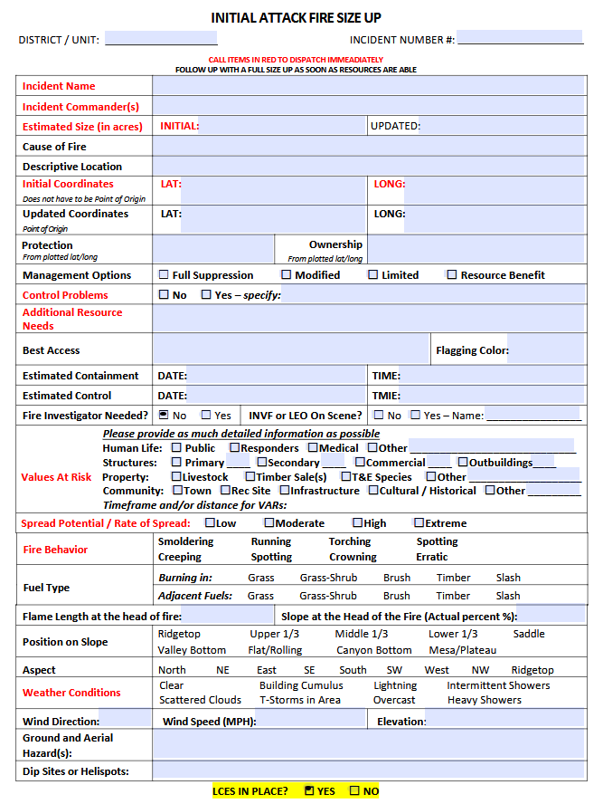
Radio Communication
Clear and Concise Radio Communication and Documentation
Use national and local forms for passing and receiving clear information
  Size-up Cards
  Medical Incident Reports
  Missing Aircraft

Slide 9
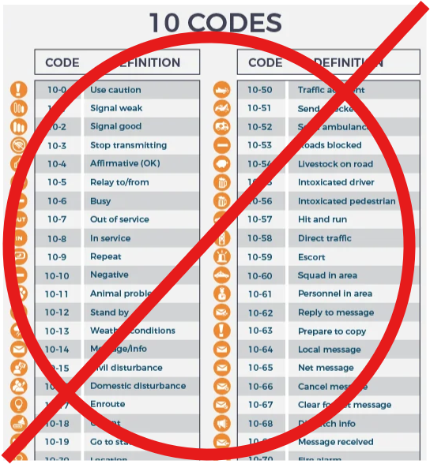
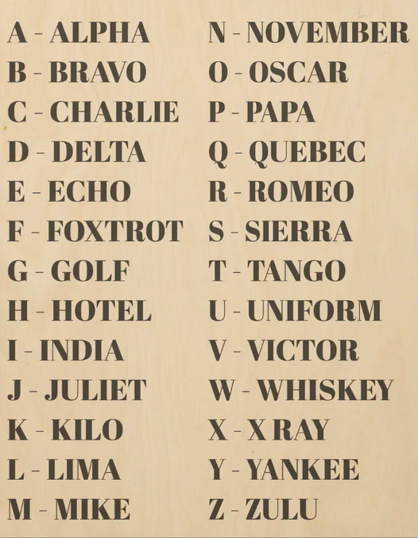
Radio Communication
Clear and Concise Radio Communication and Documentation
Use Clear Text

Slide 10
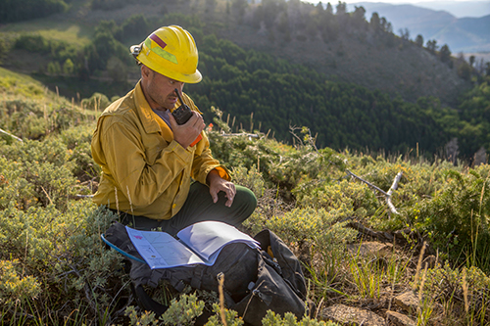
Radio Communication
Clear and Concise Radio Communication and Documentation
Common Radio Vocabulary
Standby
Break
Emergency traffic only
Disregard
Any others?

Slide 11
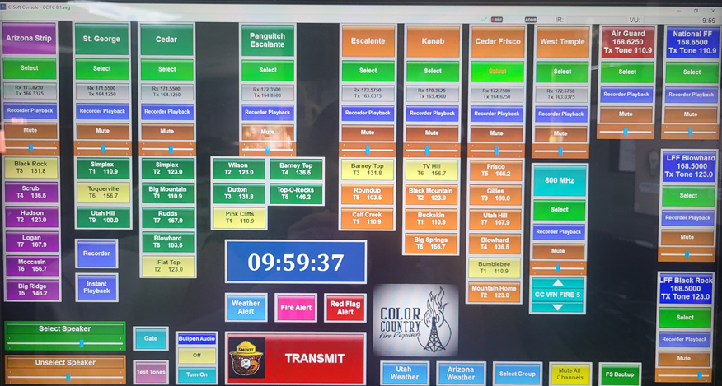
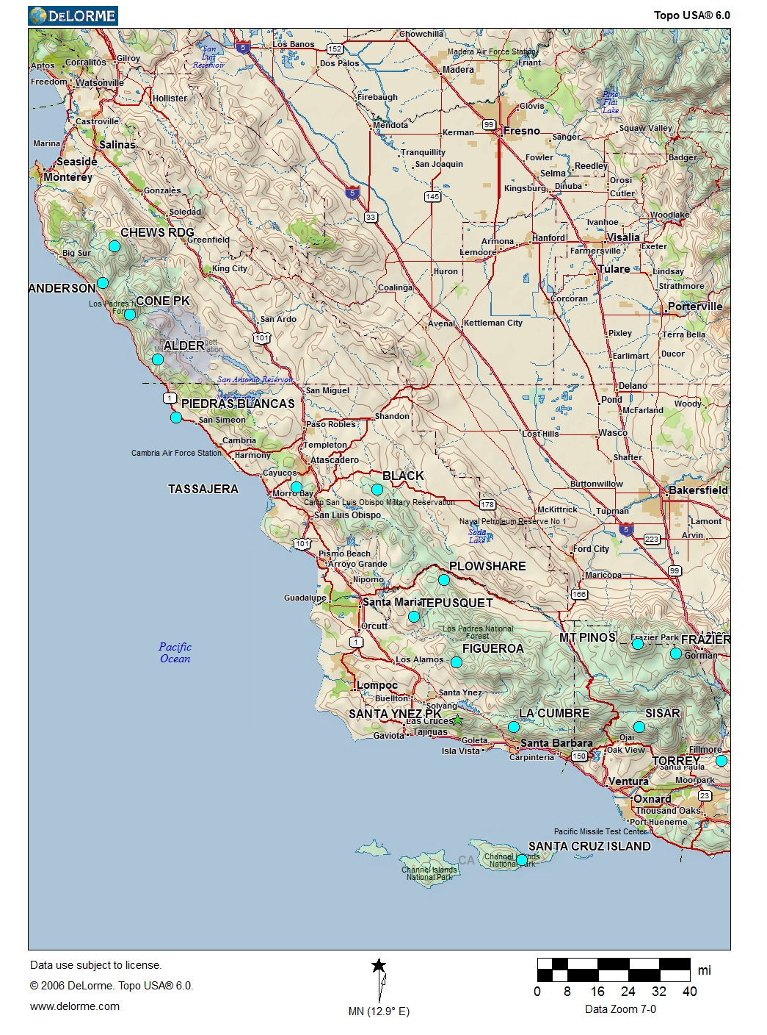
Radio Systems
Consoles and radio systems will vary by center.
Have a working knowledge of the consoles.
Know locations of repeaters in the field to communicate with personnel efficiently.
Knowledge of different frequencies and their uses.

Slide 12
Frequencies
RX (Receive) & TX (Transmit)
  Simplex vs. Duplex
  Tone Guard
Actual frequency & tone guard numbers available
Channel designators
  Local (repeater) name
  Frequency pairs
Bleed over

Slide 13
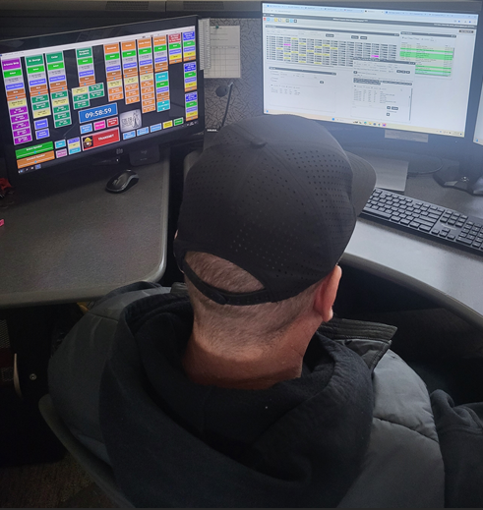
Frequency Management
Emergency Traffic:
Always has priority
It is the dispatcher’s responsibility to manage frequencies.
What is emergency traffic
Wildfires
Medical aids
Law enforcement
Vehicle accidents
Any others?

Slide 14
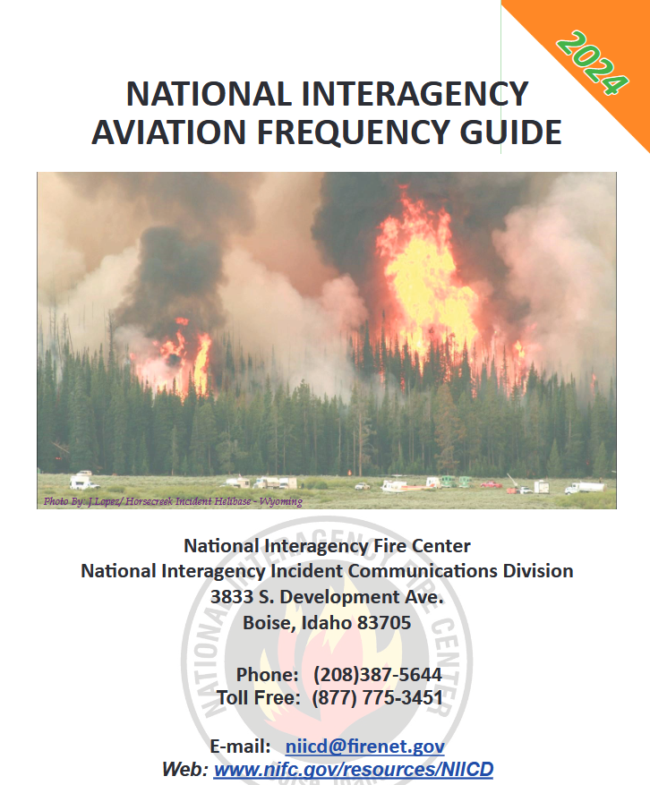
Frequency Management
On-going incidents
Once an incident becomes extended, incidents should have their own frequencies
Which frequencies should be ordered?
Ground tactical
Command
Air–to–Ground (A/G)
Any issues with national frequencies, such as bleed over, need to relayed to your GACC as soon as possible. Additional frequencies may be needed to prevent communication concerns.

Slide 15
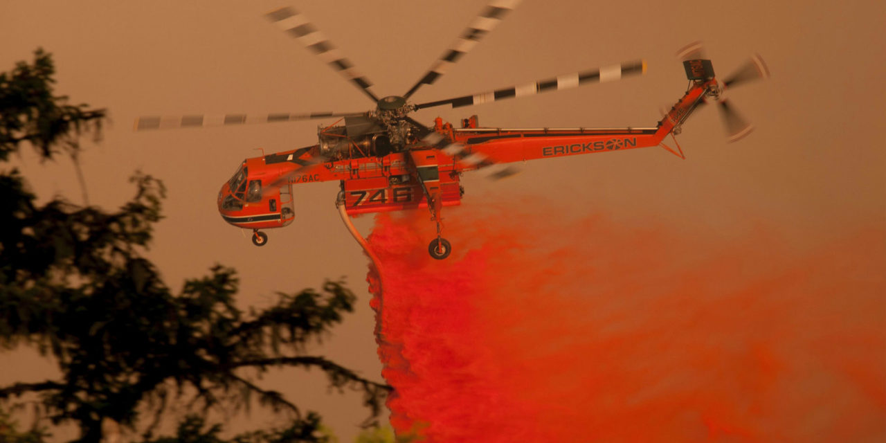
Communications with Aircraft
Frequencies Used by Agency and Cooperator Aircraft
Local frequencies for take off and landing
Local flight following frequencies
Initial attack frequencies
Air Guard Frequency
168.625
For emergency aircraft traffic only
Same frequency used for all centers
National Flight Following
168.650
Used for flight following aircraft nationally
Same frequency used for all centers for positive hand off.

Slide 16
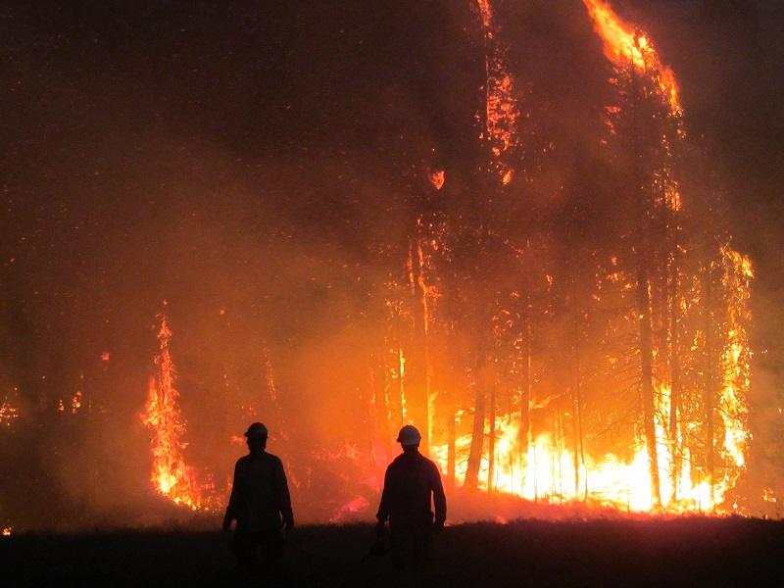
Summary
List three steps of clear and concise radio communication
List five standard radio traffic priorities
Identify frequency and radio systems
Describe five methods of frequency management
List and describe three types of frequencies used for aircraft
Notes:
Guides and Key
The presentations and instructor guides include notes to aid facilitators in instruction.
Key
Indicates an action for the instructor to take.
Indicates topics and information for the facilitator to use as they see fit.
Example Notes
Review unit objectives.
Exercise
Advise participants that the next few slides will introduce common terms that describe parts of a fire.
Pre-Video Discussion
In this scenario, firefighters have arrived on scene of a new fire. They are gathering and communicating their situational awareness of the current fire behavior.
Play Video
Title Basic Fire Terminology
Summary State the summary
Time (02:20)
Audio
Post-Video Discussion
This unit will discuss many of these terms in more detail.
Question: Identify this fire behavior.
Answer: Torching
Note to Instructor
The fuel types listed on this slide will be discussed in detail in Unit 2.
List Level 1
List Level2
Example
Example
List Level 1
List Level 1

